Slide 1

MANIPUR TECHNICAL UNIVERSITY
Takyelpat, Imphal, Manipur - 795004
Water Level Monitoring System using Microcontroller
By
Naorem Diyabarta Singh
Team Leader & Member
Ricky Thoudam
Team Member
Naoroibam Lanngamba Luwang
Team Member
diyabarta_n21@mtu.ac.in
ricky_th21@mtu.ac.in
lanngamba_n21@mtu.ac.in
Course Name: Internet of Things (CS4759)
Course Faculty: Dr. Hanjabam Saratchandra Sharma
26 December 2024

Slide 2
Table of Contents
Water Level Monitoring System using Microcontroller,
December 26, 2024
Introduction
Deployment Models
Problem Statement
Solution to the Problem
Introduction
Types of cloud computing deployment models
Unique Selling Proposition (USP)
What is the right choice for cloud deployment model?
Required Components
Overall analysis of cloud deployment models
Diagram of System Implementation
Service Models
Conclusion
Types of service models
Department of CSE, Manipur Technical University

Slide 3
Introduction
Water Level Monitoring System using Microcontroller,
December 26, 2024
The Smart Water Level Monitoring System uses IoT technology to address water scarcity and resource management challenges.
It provides real-time monitoring of water levels in tanks and reservoirs using an ultrasonic sensor, microcontroller, and OLED display.
Integrated with Blynk technology, users can monitor water levels and receive alerts on their devices.
This system automates water management, prevents overflows, conserves resources, and enhances efficiency, making it ideal for residential, agricultural, and industrial applications.
Department of CSE, Manipur Technical University

Slide 4
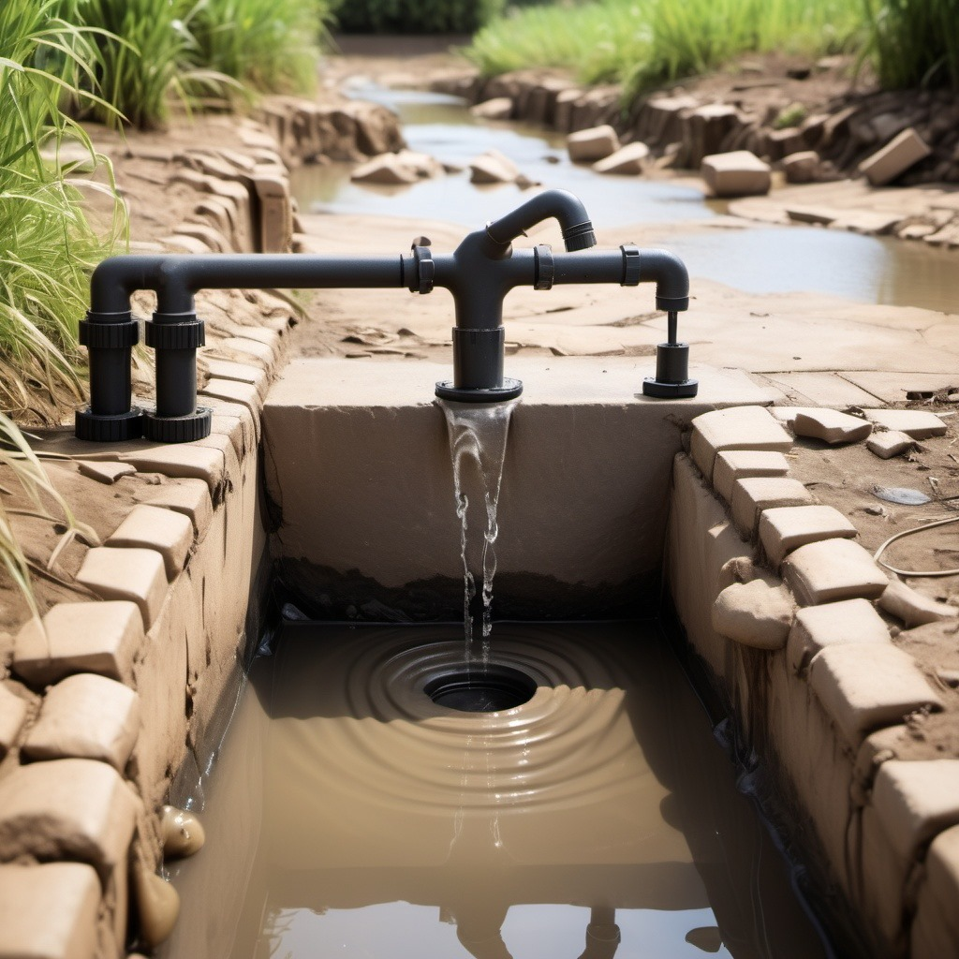

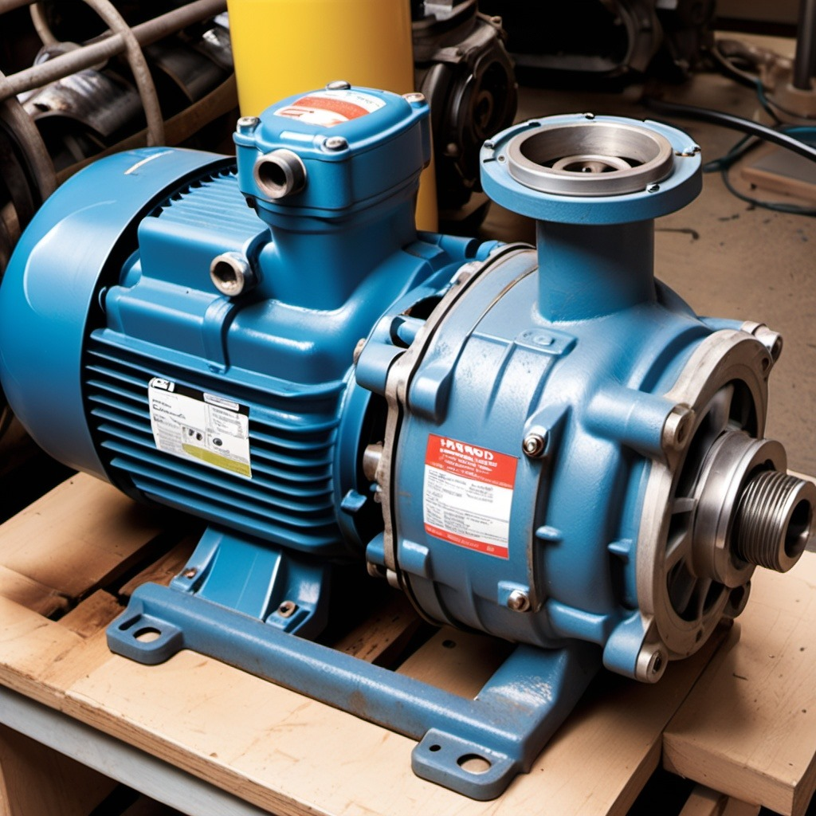
Problem Statement
Water Level Monitoring System using Microcontroller,
December 26, 2024
Human Dependency: Constant human supervision is required, making the process inefficient.
Human Dependency: Constant human supervision is required, making the process inefficient.
Pump Damage: Running pumps without water can cause motor damage due to dry running.
Department of CSE, Manipur Technical University

Slide 5
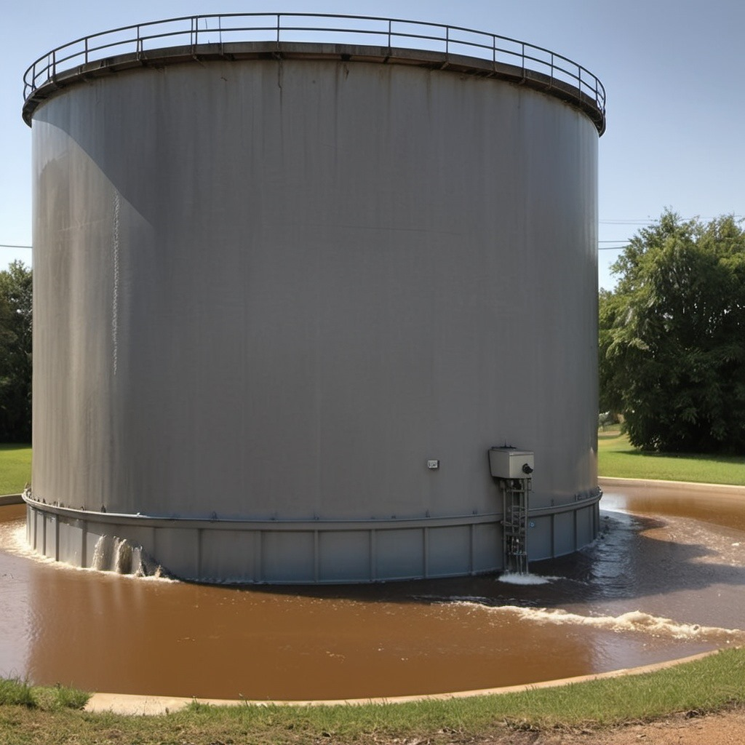
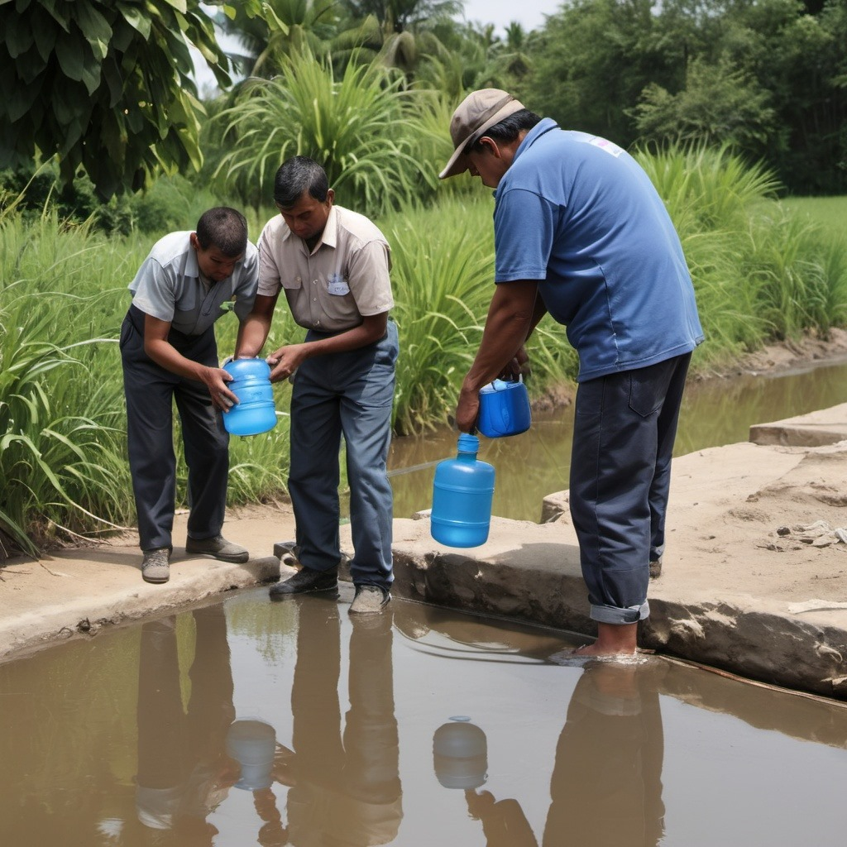
Problem Statement
Water Level Monitoring System using Microcontroller,
December 26, 2024
Lack of Alerts: No real-time notifications or alerts for critical water levels.
Inconvenience: Manual checking of water levels is time-consuming and labor-intensive.
Department of CSE, Manipur Technical University

Slide 6
Solutions to the Problems
Water Level Monitoring System using Microcontroller,
December 26, 2024
Automatic pump control stops overflow by turning the pump on/off based on water levels.
Real-time monitoring and automation reduce the need for manual water level checks.
Notifications and alerts are sent to users via the Blynk app and web dashboard.
Accurate water level data allows better water usage planning and conservation.
The OLED display and web interface provide instant water level updates.
Users can control and monitor the system remotely using IoT technology.
Department of CSE, Manipur Technical University

Slide 7
Unique Selling Proposition (USP)
Water Level Monitoring System using Microcontroller,
December 26, 2024
Simultaneous water level display on both an OLED screen and a web dashboard for better visibility and flexibility.
Designed to withstand various environmental conditions like humidity and water splashes, enhancing durability.
Water levels and functionalities can be remotely accessed from anywhere using the Blynk app and a web-based interface.
Affordable solution with scalability for both residential and industrial applications.
Department of CSE, Manipur Technical University

Slide 8
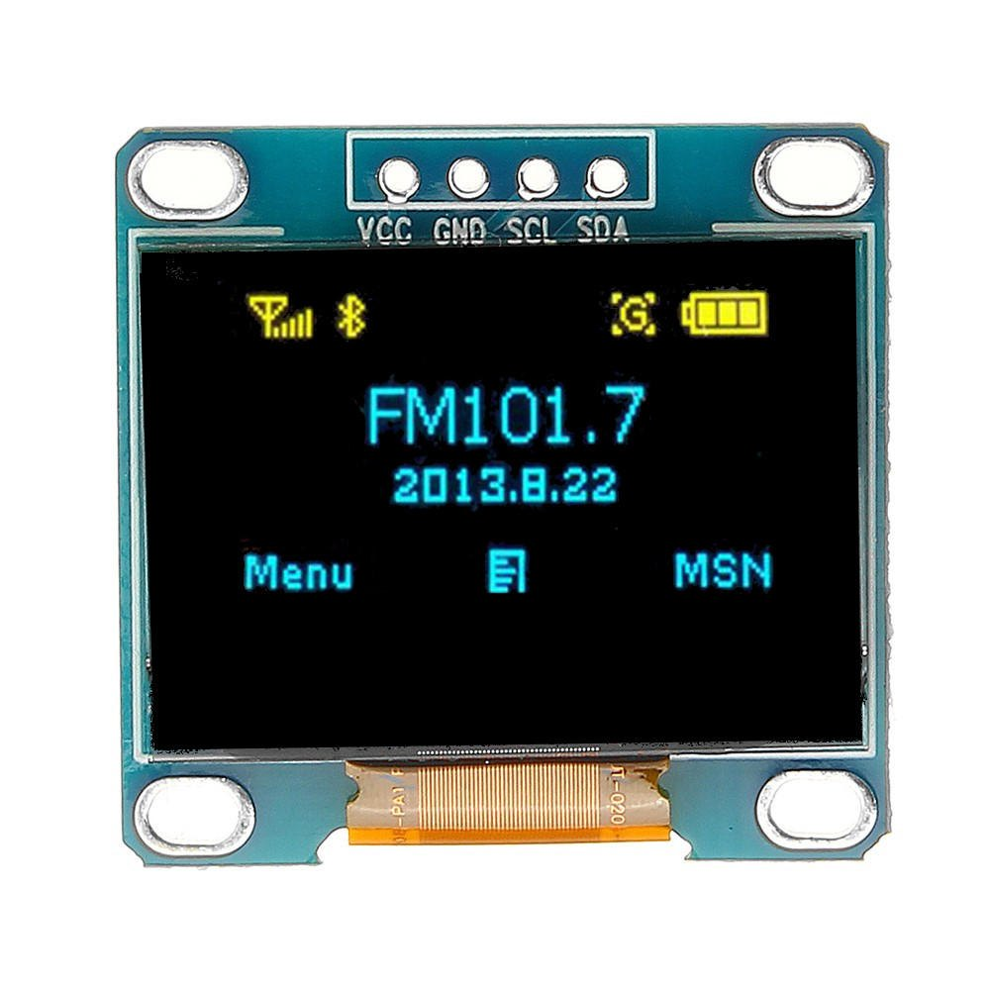
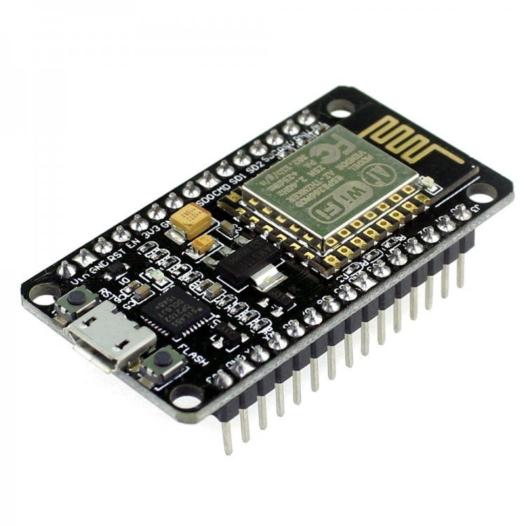
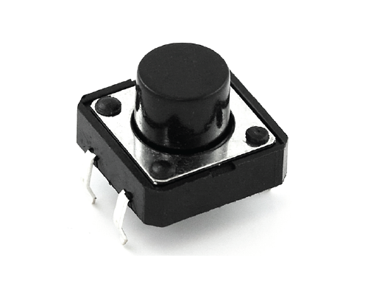

Required Components
Water Level Monitoring System using Microcontroller,
December 26, 2024
ESP8266 Node MCU
(Microcontroller)
Ultrasonic Sensor
HC-SR04
0.96’’ OLED display
Single Channel Relay
Push Button
Buzzer
Jumper Wires
Blynk Web and mobile app
Department of CSE, Manipur Technical University

Slide 9
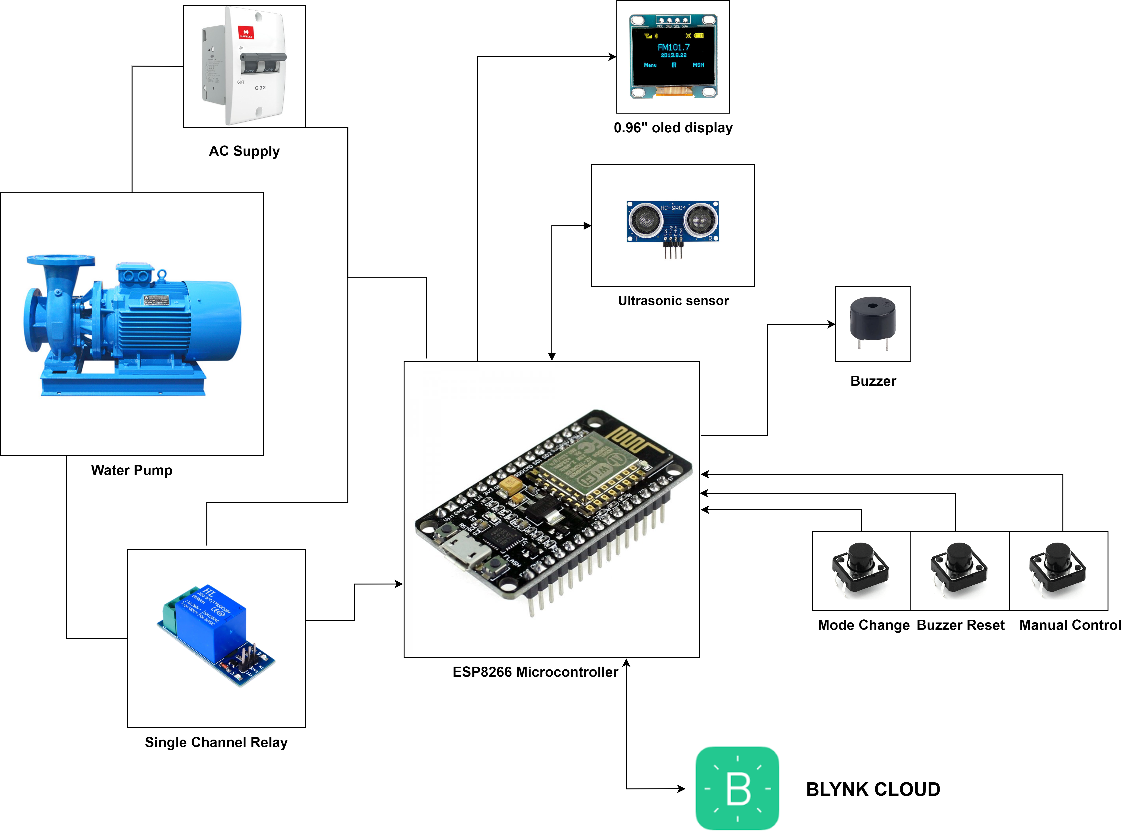
Diagram for System Implementation
Water Level Monitoring System using Microcontroller,
December 26, 2024
Department of CSE, Manipur Technical University

Slide 10
Conclusion
Water Level Monitoring System using Microcontroller,
December 26, 2024
This Smart Water Level Monitoring System leverages IoT technology to provide real-time water level monitoring, automation, and remote access.
It enhances efficiency, reduces manual labor, prevents wastage, and ensures effective water management through timely alerts.
Affordable and accessible, it is ideal for residential, agricultural, and industrial applications.
The project promotes sustainability and smarter water usage by addressing modern water management challenges.
Department of CSE, Manipur Technical University

Slide 11

Water Level Monitoring System using Microcontroller,
December 26, 2024
Thank You
Department of CSE, Manipur Technical University

